Slide 1





Sustainable plant solutions for better living.
Smart Plant Monitoring System
Supervised By:
Eng.Mahmoud Talaat

Slide 2

Our Team Members
Mohamed Hisham Hussian
Marwan Mostafa Ismail
Youhanna George Jacoub
Adham Jehad Abdelmoneam
Fares Emad Abdelnaby
Mohamed Ezzat Ghoraba

Slide 3

Table of Contents
1
2
Introduction
Problem Statment
3
4
Proposal Solution
Methodology
5
Machine Learning
Results
6
Conclusion

Slide 4


1
Introduction

Slide 5
Introduction
Agriculture today faces serious challenges in choosing the right crop for each soil type. According to global FAO reports, over 33% of the world’s soils are degraded, and poor crop–soil matching leads to major losses in productivity and increased fertilizer consumption.
Many farmers still rely on trial-and-error when deciding what to plant, which often results in higher costs and wasted resources.
Plantify aims to solve this problem using Machine Learning. By analyzing soil indicators such as N, P, K, temperature, humidity, pH, and rainfall, Plantify predicts the most suitable crop for a given soil sample.
Our model provides accurate, data-driven crop recommendations that help farmers boost productivity, optimize soil resources, and support large-scale agricultural development initiatives.

Slide 6
2
Problem Statement

Slide 7
Problem Statement
Despite advancements in agricultural technology, selecting the right crop for a specific soil type remains a major challenge due to several real-world limitations:
During large-scale agricultural planning, quick and reliable crop–soil matching is essential, yet manual assessment is slow, subjective, and prone to error.
Access to proper soil analysis tools is limited in many rural and underserved farming areas, making it difficult for farmers to accurately understand their soil’s nutrient composition.
Even agricultural technicians or extension workers may struggle to make precise crop recommendations when soil data is incomplete or unclear, increasing the risk of unsuitable crop selection.
These challenges highlight the need for an intelligent, data-driven system that can analyze soil properties and guide farmers toward the most suitable crop choices, improving productivity and resource efficiency.

Slide 8
3
Proposal solution

Slide 9


Slide 10
Overview of the proposed solution
Smart Crop Recommendation System (SCRS or Plantify)
A Machine Learning (ML) engine that translates complex soil chemistry into precise, dual-action planting and resource guidance.
System Workflow:
Input & Preprocessing:
Accepts soil and climate parameters (e.g., N, P, K, pH, Moisture, Temperature, Rainfall) from tests or sensors.
Core ML Engine (Dual Prediction):
Model: Utilizes a powerful predictive model (LightGPM).
Prediction 1 (Classification): Identifies the Optimum Crop for the given soil profile.
Output & Interface:
Delivers clear, actionable advice to the user: "Plant [Crop X], With [Y kg] Fertilizer, and [Z Liters] Water."

Slide 11
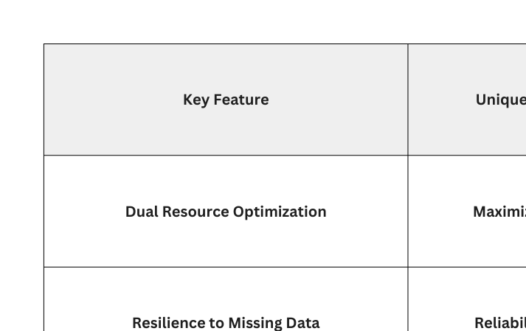
Unique Value Proposition (UVP)

Slide 12
4
Methodology

Slide 13



Slide 14
Data Collection
To ensure high-quality and realistic training data, we created a FAO-based regenerated dataset derived from internationally recommended soil and climate ranges.
The dataset contains 66,000 samples, each representing a complete soil profile with N, P, K, temperature, humidity, pH, and rainfall.
We included 22 different crops, assigning 3,000 samples to each crop to maintain perfect class balance and support robust predictive modeling.
These crops include fruits, vegetables, cereals, legumes, and industrial crops, ensuring that the model learns from a wide variety of soil–crop relationships.
The dataset features crops such as: Rice, Maize, Chickpea, Kidney Beans, Pigeon Pea, Moth Beans, Mung Beans, Black Gram, Lentils, Pomegranate, Banana, Mango, Grapes, Watermelon, Muskmelon, Apple, Orange, Papaya, Cucumber, Coconut, Cotton, and Jute.
This diversity enables Plantify to generate accurate and reliable recommendations across different soil conditions and farming needs.

Slide 15
Exploratory Data Analysis
Before training the model, we conducted a full exploratory data analysis (EDA) to understand the behavior of the soil features and how they relate to each crop class.
We visualized the distributions of the seven main features (N, P, K, temperature, humidity, pH, and rainfall), examined correlations between them, and analyzed how each feature varies across the 22 crop categories.
This step helped us identify feature patterns, nutrient trends, and climate–soil relationships that influence crop suitability.

Slide 16
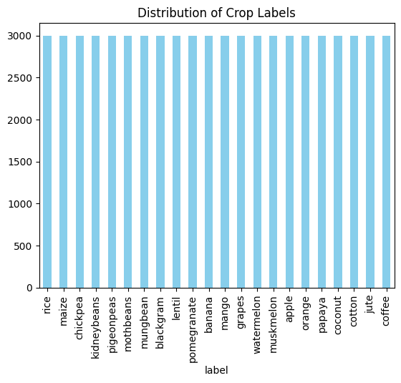
Exploratory Data Analysis
Crop Label Distribution
This chart shows that all 22 crop classes contain the same number of samples (3,000 each).
The perfectly balanced distribution ensures that the model trains fairly and avoids bias toward any specific crop.

Slide 17
Data Analysis
During the data analysis stage, we focused on understanding how soil properties vary across different crop types and how each feature contributes to crop suitability.
We examined the statistical behavior of the seven core features (N, P, K, temperature, humidity, pH, and rainfall), identifying typical ranges and differences between crop categories.
Visual analysis was performed using distribution plots, boxplots, and correlation heatmaps to highlight key patterns within the dataset.
We also compared average feature values across the 22 crops, which helped us observe nutrient requirements and preferred climate conditions for each crop type.
These insights guided our feature engineering choices and ensured that the model was trained with a solid understanding of soil–crop relationships.

Slide 18
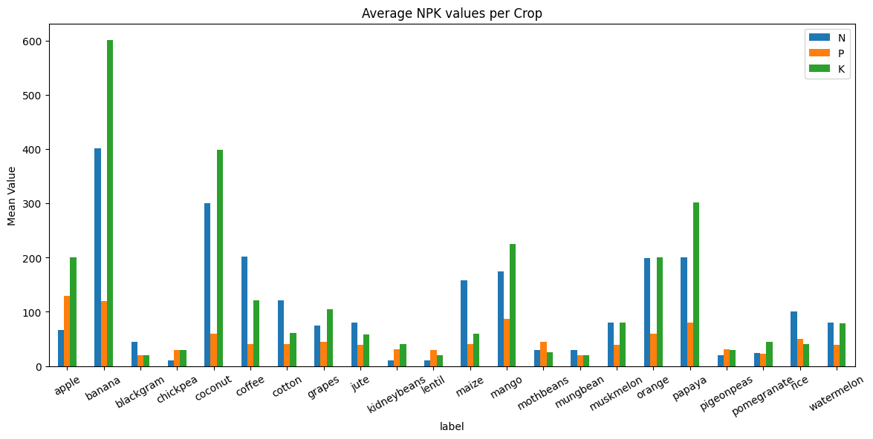
Data Analysis
Average NPK values per Crop Bar Chart

Slide 19
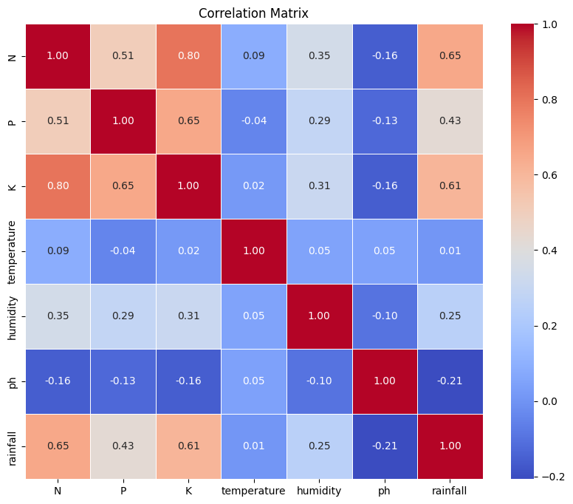
Data Analysis
Correlation Heatmap
The heatmap shows strong positive correlations between the soil nutrients N, P, and K, especially between N and K (0.80) and P and K (0.65). This indicates that nutrient levels often increase or decrease together across samples.
Rainfall also has a noticeable positive relationship with the nutrient features (0.65 with N, 0.43 with P, and 0.61 with K), suggesting that higher rainfall is generally associated with richer nutrient content.
In contrast, temperature, humidity, and pH show very weak correlations with most other features, meaning they contribute independent information to the dataset.
The weak overall correlations across climate and pH variables indicate low multicollinearity, allowing the model to learn distinct patterns from each feature.

Slide 20
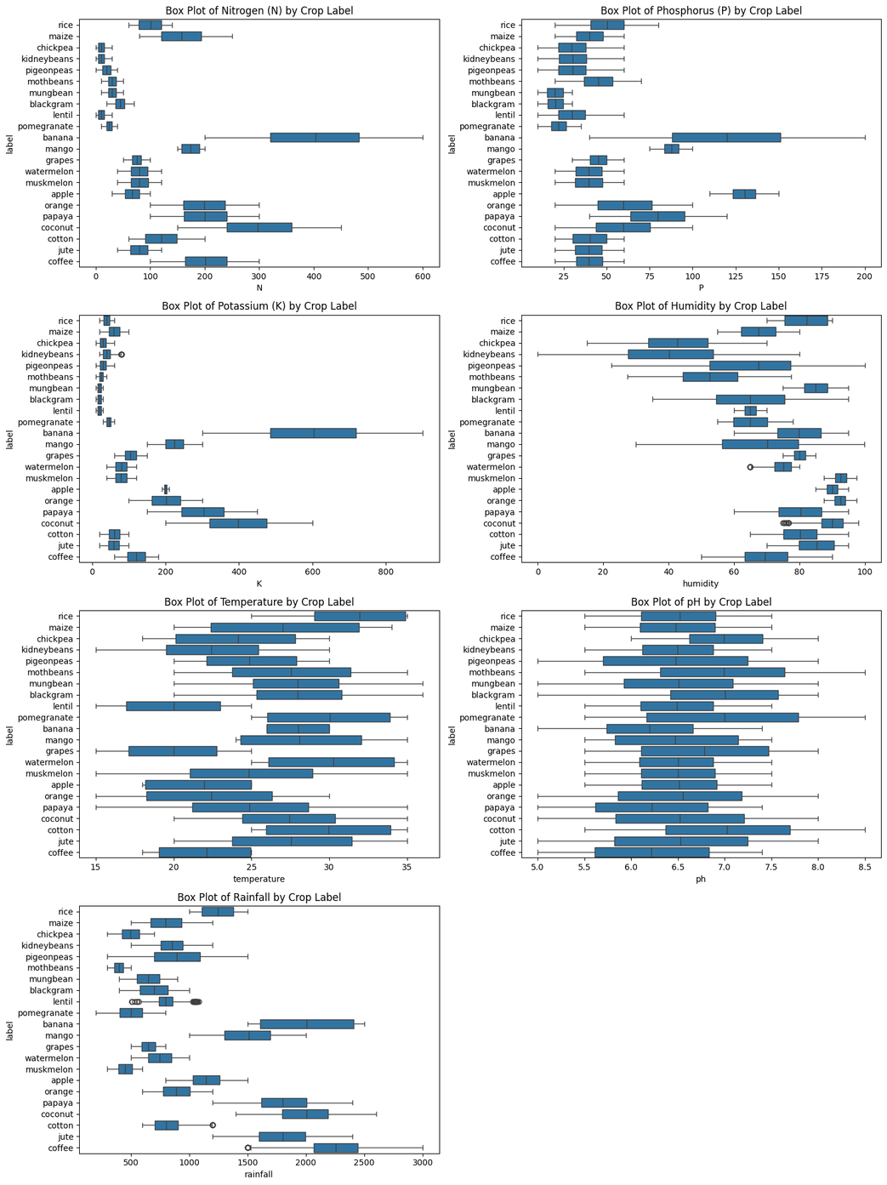
Data Analysis
Boxplots Across Crops
Nitrogen (N): The nitrogen boxplot shows clear variation across crops, with some requiring high nitrogen levels while others grow in much lower ranges. This makes nitrogen an important feature for distinguishing crop types.
Phosphorus (P): The phosphorus boxplot highlights noticeable differences in P requirements among crops. Some crops tend to have higher phosphorus levels, helping reveal their specific nutrient needs.
Potassium (K): Potassium displays one of the widest separations between crops, showing significant variation in K demands. This makes potassium a strong indicator for identifying suitable crops.
Humidity: The humidity boxplot shows large differences in moisture preference. Some crops thrive in high humidity while others prefer drier conditions, reflecting their environmental requirements.

Slide 21
Data Analysis
Temperature: The temperature boxplot indicates that each crop tends to fall within a characteristic temperature range. These differences help identify the climate conditions best suited for each crop.
pH: The pH boxplot shows that crops prefer different acidity levels, with some having narrow pH ranges and others being more flexible. This helps determine compatibility with soil acidity.
Rainfall: The rainfall boxplot reveals strong variation in water requirements across crops. Some crops depend on high rainfall, while others grow better in low-rainfall environments, making rainfall a highly discriminative feature.

Slide 22
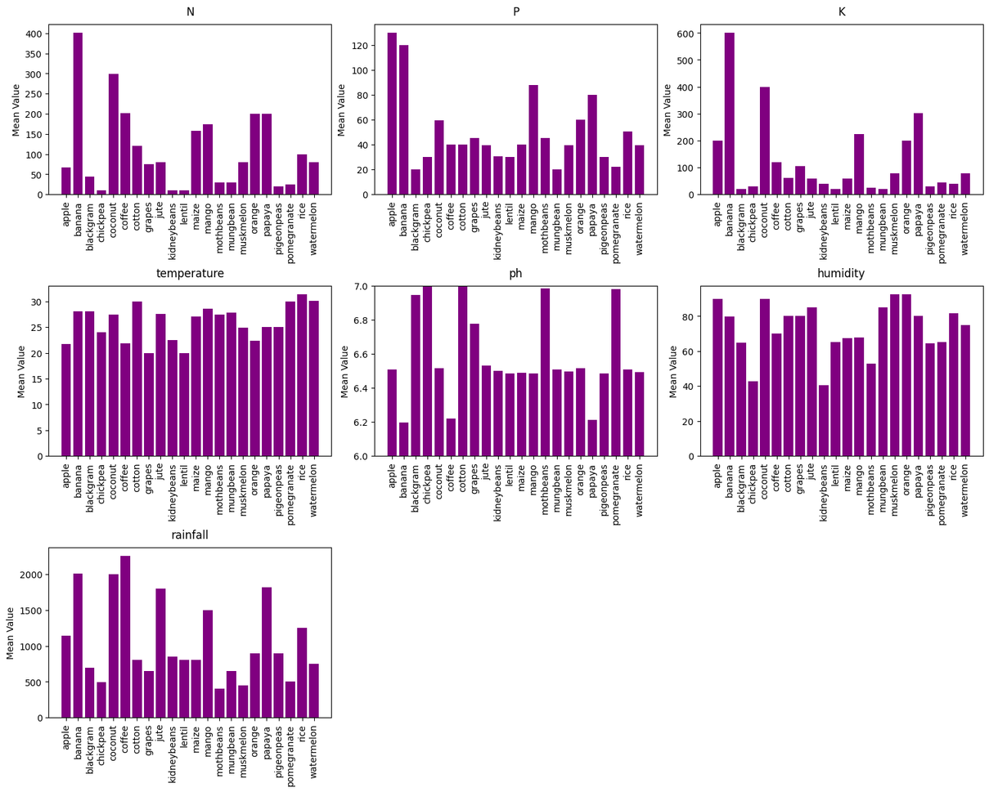
Data Analysis
Mean Feature Values per Crop
These bar charts show the average value of each soil feature across the 22 crop types.
Clear differences appear in nutrient levels, climate conditions, and rainfall requirements for each crop.
These patterns help reveal the unique environmental and soil needs of every crop, allowing the model to learn how each feature contributes to crop suitability.

Slide 23
Feature Engineering
Based on the insights from EDA, we applied domain-based feature engineering to extract additional soil-related indicators.
We generated the NPK_Ratio to represent the overall nutrient balance in the soil, and we introduced a climate_type feature that groups samples into four environmental categories: hot–dry, hot–humid, cool–dry, and cool–humid.
These engineered features were useful in understanding soil–crop interactions and validating the model’s behavior during analysis.
After completing EDA, data analysis, and feature engineering, we applied a stratified 80/20 train–test split to preserve balanced representation across all 22 crops and prepare the dataset for model training.

Slide 24
Data Preprocessing
Before training the model, we prepared the dataset through a set of preprocessing steps.
We first separated the features (N, P, K, temperature, humidity, pH, rainfall) from the target crop label to structure the data clearly for modeling.
After that, we applied a stratified 80/20 train–test split to ensure that all 22 crop classes kept the same balanced distribution in both training and testing sets.
Stratification was essential because it preserved the equal representation of each crop, preventing the model from becoming biased toward any particular class.
With the data organized, balanced, and properly split, it was ready to be passed into the machine learning model for training.

Slide 25
5
Machine Learning Results

Slide 26
Machine Learning Results
Two classification models ,Random Forest and LightGBM—were developed to predict the most suitable crop based on soil indicators such as N, P, K, temperature, humidity, pH, and rainfall.
Both models were evaluated using accuracy and F1-score to assess their effectiveness in learning and distinguishing between crop classes.
The Random Forest model achieved an accuracy of 93%, demonstrating strong predictive capability and stable performance across the dataset.
The LightGBM model outperformed it with an accuracy of 95.42%, reflecting its ability to capture complex patterns and feature interactions more efficiently.
Visual examination of the classification outputs further confirmed LightGBM’s superior consistency, with higher F1-scores indicating well-balanced performance across crop categories.
Overall, the results highlight the robustness of the modeling approach and identify LightGBM as the most reliable model for generating accurate crop recommendations within the Plantify system.

Slide 27
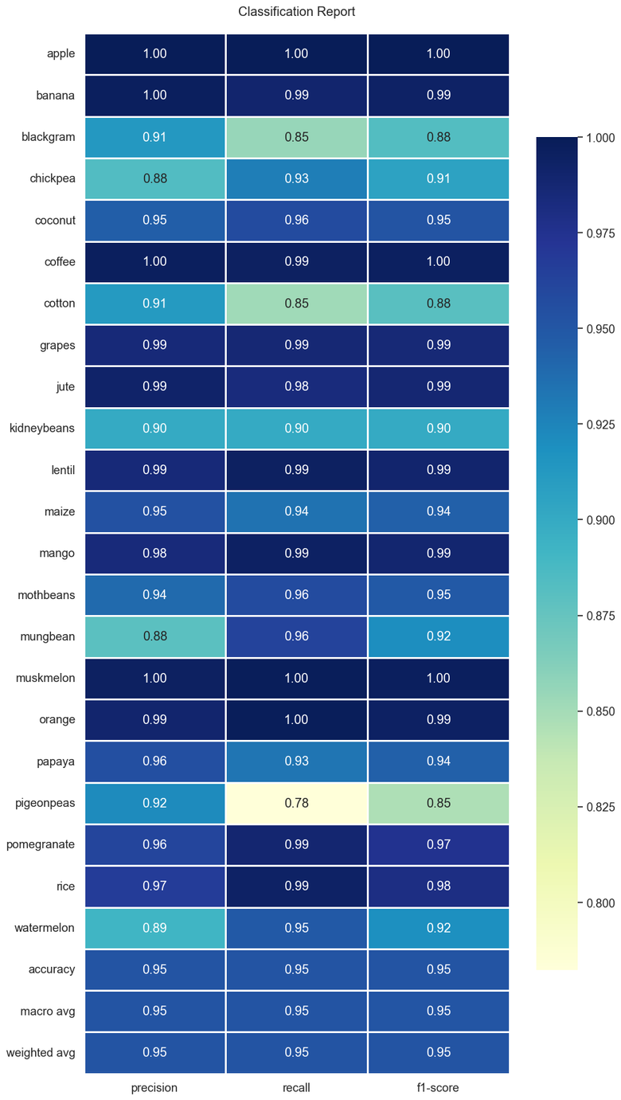
Model Evaluation
Classification Report (Summary)
The model achieves 95% accuracy, showing strong overall performance.
Most crop classes have very high precision, recall, and F1-scores (0.95–1.00).
Best-performing crops: apple, coffee, muskmelon, grapes, and orange.
Overall, the model is well-generalized, with only a few classes needing improvement.

Slide 28
6
Deep Learning
Computer Vision

Slide 29
What we did
Downloaded and organized plant-disease images from Kaggle and
Prepared two versions: Color images and
Grayscale-images then
We split dataset into Train, Validation, and Test.
Goal: Train an AI model to identify plant diseases from images.
We used EfficientNetB0 pretrained model (ImageNet) to
Preprocessed images: resizing, normalization,
optional augmentation.
Built classification layers on top of the base model.
Trained a model for Color and another for Grayscale to compare performance.

Slide 30
Model Deployment
We developed an interactive web application using Streamlit to make the crop-prediction system accessible, intuitive, and easy to use for different types of users.
The interface begins with a role-selection screen, allowing users to choose between Business User and Scientific Researcher, ensuring a customized experience for each audience.
In the Scientific Researcher Hub, users can input soil and climate parameters—including N, P, K, temperature, humidity, pH, and rainfall—to generate instant crop recommendations powered by the LightGBM model.
The system displays prediction probabilities, top crop recommendations, and additional crop information in a clean and visual format to support decision-making.
Users can upload their own CSV dataset to analyze trends, visualize patterns, and explore data directly through the app.
A dedicated Chat with AI mode allows users to ask questions about the data, features, and insights, simplifying technical interpretation and making the tool more interactive.
Overall, Streamlit enabled rapid deployment of a fully functioning AI application that provides real-time predictions, data exploration, and an engaging user experience without requiring complex backend development.

Slide 31
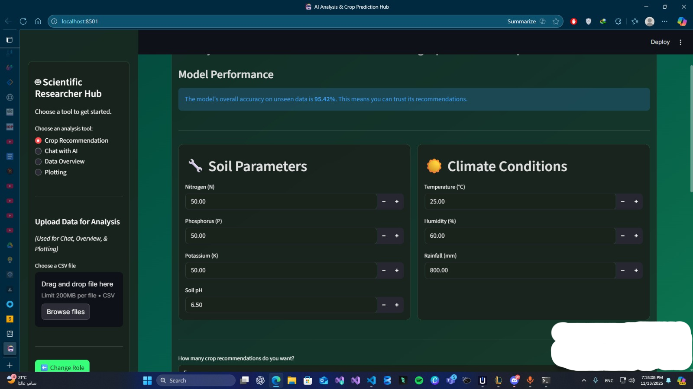

Slide 32
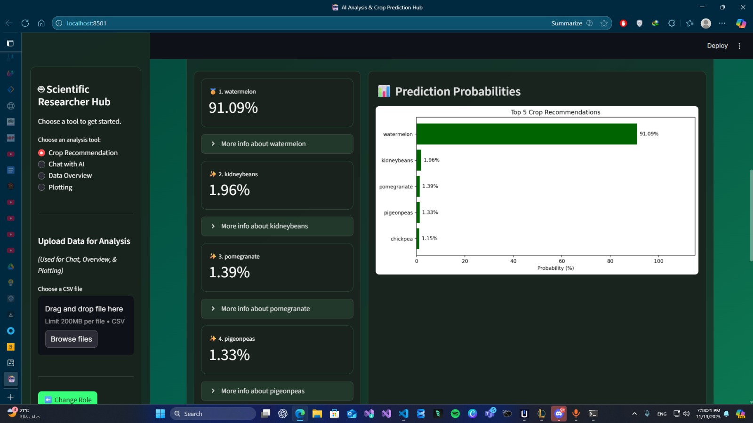

Slide 33


Slide 34
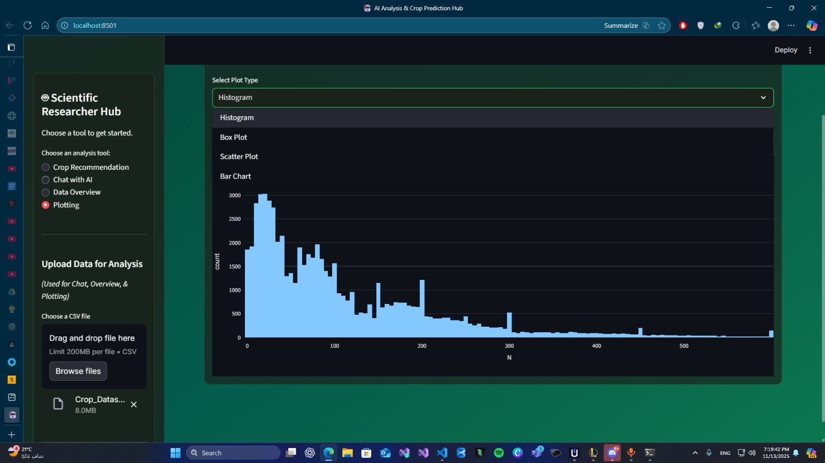

Slide 35
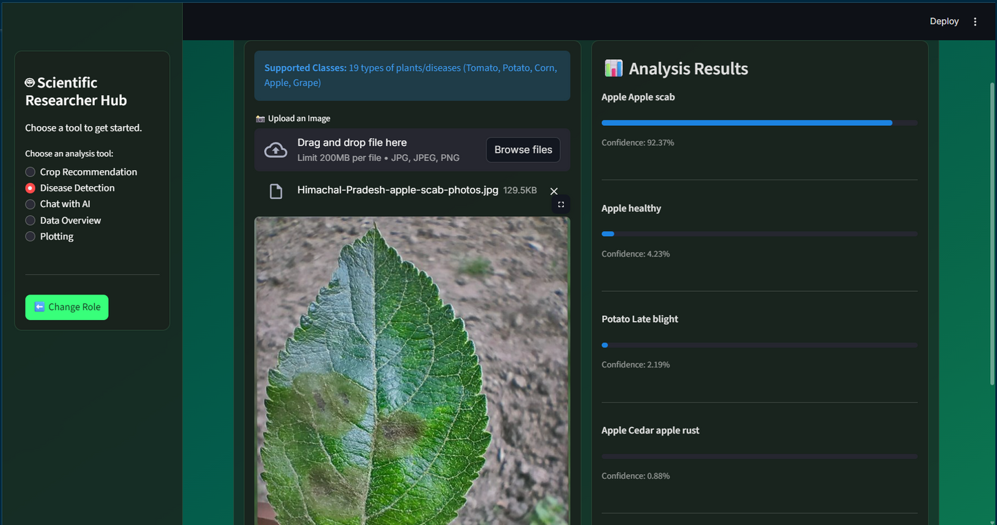
Model Results
Model predicted diseases correctly on test samples.
Color-based model performed slightly better (more details).
Recommended to include image samples of Color & Grayscale.

Slide 36
Conclusion
The project successfully developed a smart crop recommendation system using soil and climate indicators to support data-driven agricultural decisions.
After evaluating multiple models, LightGBM achieved the highest performance with 95.42% accuracy, proving its effectiveness and strong generalization.
Streamlit was used to deploy the system, transforming the machine learning models into an interactive and user-friendly web application.
The platform enables real-time predictions, data exploration, and seamless interaction for both researchers and agricultural users.
By integrating AI with an accessible interface, the system provides practical value for improving crop selection and optimizing farming resources.
Overall, the project demonstrates the potential of machine learning to enhance agricultural productivity and support smarter, more efficient farming practices.

Slide 37



Success
Developed a smart system utilizing soil and climate indicators for data-driven decisions.
Performance
LightGBM achieved 95.42% accuracy, proving high effectiveness and generalization.
Accessibility
Streamlit deployment bridges the gap between complex AI and practical agricultural use.

Slide 38







Tools
C++ programming language
python programming
language
Sciikit learn library
Google Colab
Gemini API
Light GBM Machine Learning model
Web interface with Streamlit

Slide 39
Marwan Mostafa Ismail
Fares Emad Abdelnaby Elsayed
Youhanna George Jacoub Ibrahim
Mohamed Hisham Hussian Mahmoud
Adham Jehad Abdelmoneam Eloraby
Mohamed Ezzat Saad Ghoraba
Thank You
Very Much!
We are open to questions regarding our Methodology, LightGBM Model results, or the Streamlit implementation.

